Slide 1
COCO SCAN
A Mobile-Based AI System for Coconut Leaf Disease Detection
Submitted by Hasitha Eroshana Perera
Cardiff Metropolitan University | BSc Software Engineering

Slide 2
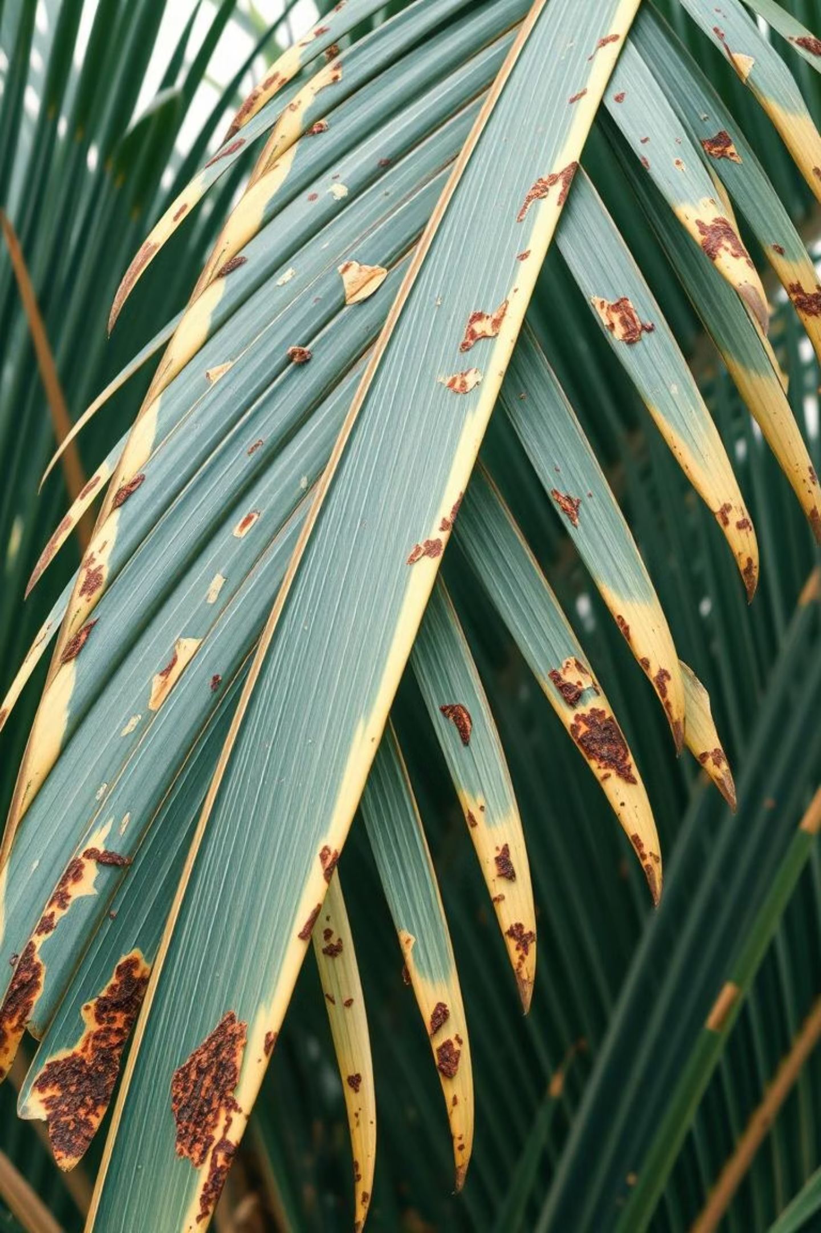
The Challenge: Protecting Sri Lanka's "Tree of Life"
Coconut farming is vital to Sri Lanka's economy, providing food, income, and jobs. However, leaf diseases like Bud Rot and Gray Leaf Spot severely impact harvests, weakening or even killing trees.
Crop Loss & Income Reduction
Slow, Inaccurate Detection
Manual methods are slow, unreliable, and often too late to save trees.
Diseases lead to fewer coconuts and significant income loss for farmers.
Costly Lab Testing
Lab tests are expensive and impractical for most small farmers.

Slide 3
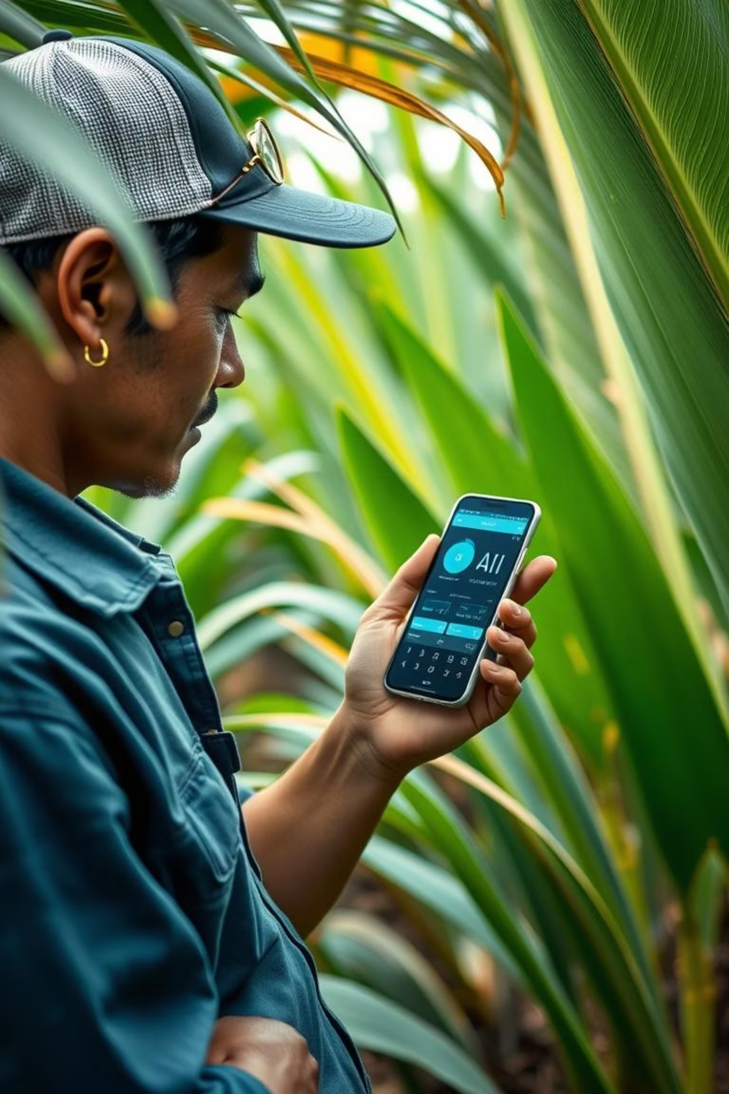




Introducing COCO SCAN: An AI-Powered Solution
COCO SCAN is a mobile application designed to help Sri Lankan farmers detect coconut leaf diseases quickly and accurately using their smartphone cameras.
Instant AI Detection
Uses AI to analyze leaf photos and provide results within seconds.
Offline Functionality
Works without internet, crucial for rural areas with poor connectivity.
Multilingual Support
Offers treatment advice in Sinhala, Tamil, and English.
Actionable Treatment Advice
Provides immediate recommendations for disease management.

Slide 4

Project Objectives: Empowering Farmers
1
Enhance Early Detection
Identify challenges in early disease detection and analyze how technology can improve crop health and productivity.
2
Leverage Artificial Intelligence
Explore AI's role in classifying diseased leaves, designing and implementing an AI-based system for accuracy and efficiency.
3
Support Farmers via Mobile App
Identify gaps in current disease management and develop a mobile app to improve accessibility, awareness, and decision-making.

Slide 5
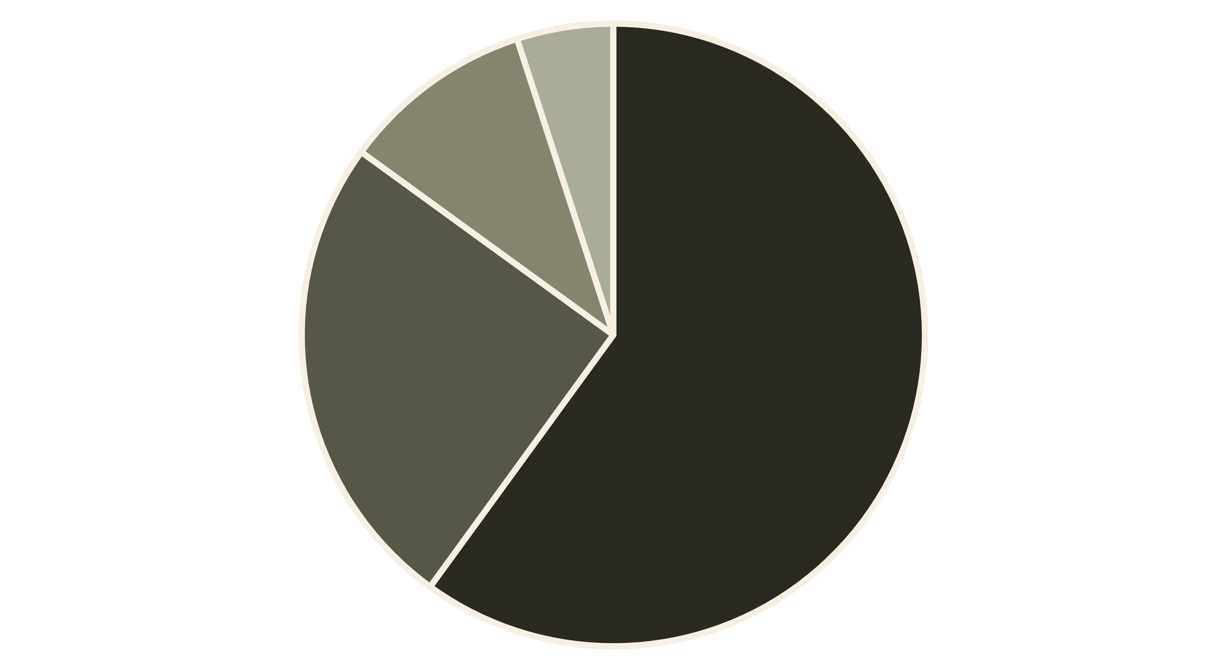
Current Disease Detection Methods in Sri Lanka
Manual Observation
Agricultural Officer
Laboratory Testing
No Active Monitoring
The majority of farmers (60%) rely on manual observation, which is often inaccurate and leads to late detection. Agricultural officers (25%) are reliable but limited in availability, while lab testing (10%) is accurate but costly and slow. This highlights the urgent need for a fast, affordable, and accessible system like COCO SCAN.

Slide 6


Project Feasibility & Key Challenges
Feasibility
Challenges & Mitigation
Technical
Low Tech Adoption
Feasible with React Native, TensorFlow Lite for mobile AI.
Training, simple design, demonstrations.
Operational
Limited Internet
Replaces manual methods; intuitive design, multilingual.
Offline mode, local storage, lightweight app.
Financial
Small Dataset
Moderate initial costs, strong ROI via reduced crop loss.
Expand dataset with CRI, augmentation.
Legal
Data Privacy
Complies with PDPA, agricultural guidelines.
PDPA compliance, encryption, consent forms.

Slide 7
AI's Role: Learning from Other Crops
AI has proven successful in plant disease detection for various crops, but coconut has been largely underserved.
Tomato
Leaf disease detection
90%+
Wakefield, 2020
Rice
Rice blast detection
88%
Ernst, 2019
Maize
Leaf spot detection
91%
Brincat, 2019
Coconut
Limited research
Not widely applied yet
Kumarage, 2022
This gap presents a unique opportunity for COCO SCAN to bring AI benefits to coconut farmers.
MobileNetV2
ResNet50
EfficientNetV2
Fast, small, but lower accuracy (~82%).
High accuracy (~86%), but heavy and slow.
Best balance: High accuracy (~90%), moderate size, fast.

Slide 8
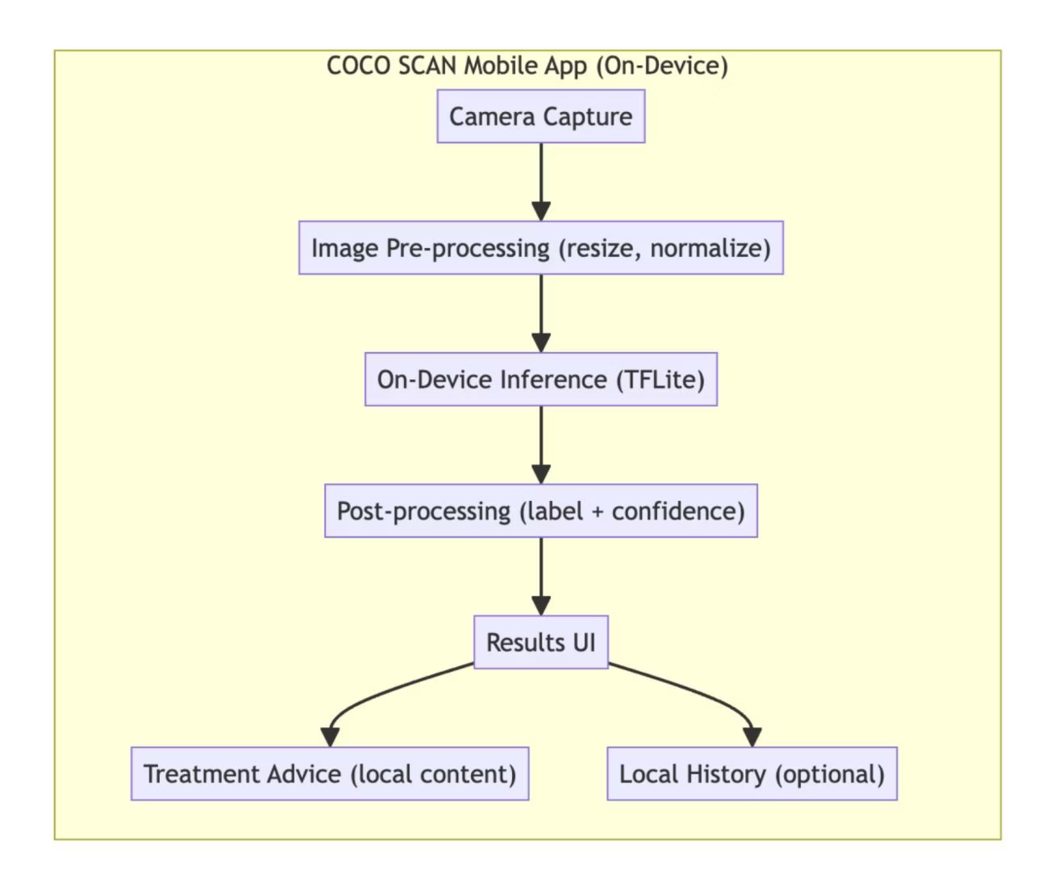





How COCO SCAN Works: System Architecture & Flow
Capture Image
Farmer takes a photo of the coconut leaf.
Process & Analyze
Image is pre-processed and sent to the AI model for inference.
Display Results
Model returns disease prediction and confidence score.
Provide Advice
App fetches relevant treatment advice from local knowledge base.
Save History
Farmer can optionally save results for future reference.
The system is a lightweight, mobile-first, offline application. Images are processed locally through pre-processing before being passed to the on-device AI model (TensorFlow Lite).

Slide 9
Ensuring Accuracy: Testing & Validation
Rigorous testing confirmed COCO SCAN's accuracy, performance, and usability.
90%
2.8s
16MB
Overall Accuracy
Avg. Response Time
Model Size
Achieved by EfficientNetV2 model.
Fast predictions on mobile devices.
Optimized for low-end devices.
TC 01
Image Capture
Farmer takes photo
Image captured & displayed
Pass
TC 02
Disease Detection
Gray Leaf Spot image
"Gray Leaf Spot" + score
Pass
TC 03
Treatment Advice
Bud Rot detection
Guide in local language
Pass
TC 04
Offline Mode
App without internet
Detection still runs
Pass

Slide 10




Conclusion & Future Vision
COCO SCAN successfully provides an accessible, offline-first solution for coconut leaf disease detection, empowering farmers and reducing crop losses in Sri Lanka. It's a significant step towards integrating digital innovation into agriculture.
Scale Nationally
Pilot deployments in key districts.
Expand Dataset
Continuous collection for improved accuracy.
Strengthen Partnerships
Collaborate with government, CRI, NGOs.
Build Ecosystem
Expand to other crops, pest detection.

